Slide 1



TruthTrack
- FAKE NEWS PREDICTION SYSTEM
Presented by :
RESHMA A- 210701211
RESHMA S - 210701213

Slide 2

INTRODUCTION
ABSTARCT
SYSTEM ARCHITECTURE
DATA COLLECTION
DATA PROCESSING
MODEL TRAINING
MODEL EVALUATION
APPLICATION DEVELOPMENT
OUTPUT
CONCLUSION
FUTURE ENHANCEMENT
AGENDA

Slide 3




INTRODUCTION
Purpose: Develop an automated system to
detect fake news using machine learning techniques.
Problem: Rapid spread of misinformation via the internet and social media affects society and individuals.
Objective: Improve news reliability and reduce the dissemination of false information.
Approach: Utilize machine learning algorithms to analyze and classify news articles as real or fake.

Slide 4

ABSTRACT
Purpose: Develop an automated system to
detect fake news using machine learning techniques.
Significance: Address the growing issue of misinformation spread through online and social media platforms.
Methodology: Employed Logistic Regression with text preprocessing, TF-IDF vectorization, and stemming techniques.
Outcome: Developed a model to predict the authenticity of news articles, enhancing the accuracy and reliability of information dissemination.
Goal 1

Slide 5
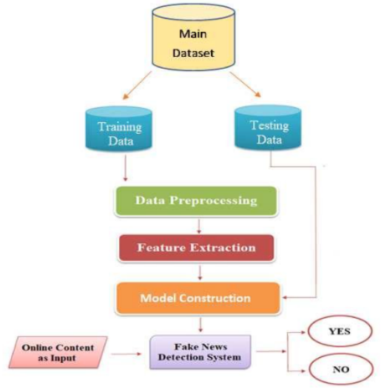
SYSTEM ARCHITECTURE
Goal 1

Slide 6
Data Collection
Dataset Source: Used a subset of the 'train.csv' dataset from a publicly available source like kaggle.
Preprocessing: Combined author and title to form the content, and handled missing values by filling them with empty strings.
Sampling: Randomly selected 50% of the data for use to ensure manageability and reproducibility.
Goal 1

Slide 7
Data Preprocessing
Text Cleaning: Removed non-alphabetic characters and converted text to lowercase.
Stopword Removal: Eliminated common English stopwords to focus on significant words.
Stemming: Applied the Porter Stemmer to reduce words to their root form.
Vectorization: Converted text to numerical form using TF-IDF Vectorizer.
Goal 1

Slide 8
Model Training
Model Choice: Selected Logistic Regression for its efficiency and effectiveness in binary classification tasks.
Train-Test Split: Split the dataset into training (80%) and testing (20%) sets.
Training Process: Trained the Logistic Regression model on the training data.
Goal 1

Slide 9
Model Evaluation
Performance Metrics: Used accuracy score to evaluate model performance.
Results: Achieved satisfactory accuracy on the test set, indicating the model's reliability in predicting fake news.
Comparison: Compared performance with other potential models and chose Logistic Regression based on results.
Goal 1

Slide 10
Application Development
Framework: Utilized Flask to build the web application.
User Interface: Designed a simple UI using HTML templates.
Prediction Mechanism: Enabled users to input author and title to predict the authenticity of news.
Response Time: Implemented a 5-second delay for realistic processing time simulation.
Goal 1

Slide 11
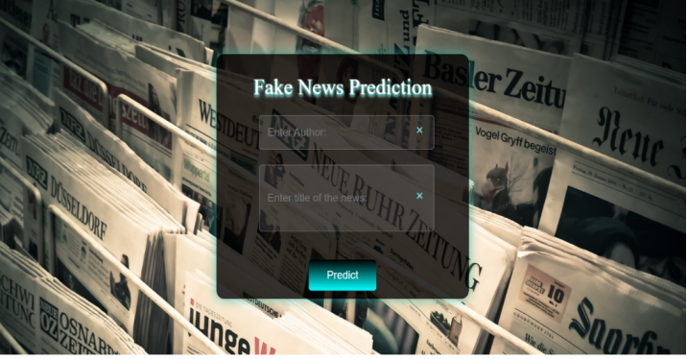
OUTPUT
Goal 1

Slide 12

OUTPUT
Goal 1

Slide 13
CONCLUSION
Summary: Successfully built a machine learning model and integrated it into a web application to detect fake news.
Impact: Provided a tool that can assist users in verifying the authenticity of news articles, contributing to reducing misinformation.
Future Work: Plans to enhance the model's accuracy and expand its capabilities by incorporating more sophisticated machine learning techniques and larger datasets.

Slide 14
Future Enhancement
Algorithm Improvement: Explore advanced algorithms and ensemble methods to improve prediction accuracy.
Dataset Expansion: Incorporate larger and more diverse datasets for training.
Real-Time Processing: Optimize the application for real-time fake news detection.
User Experience: Enhance the UI for better user interaction and feedback mechanisms.
Goal 1

Slide 15

Rehma S & Reshma A
Thank You
LDR SENSOR

